Slide 1
Name:R.Thirisha College code :6202 Reg:620221104033
BUILDING BUS RESERVATION SYSTEM

Slide 2
Abstract
The software achieved is capable of improving the customer hand and relationship management in ITC operations
It maintains all customer details, bus details, reservation details.
OBTRS is built for managing and computerizing the traditional database, ticket booking and tracking bus and travel made
Furthermore, other operations carried by ITC such as the courier services should also be integrated in order to enhance the system

Slide 3
Problem statement
Highly secure and the problem statement for online bus and the money. Tell you on this page of working email id to know that one of the corporation
Server onto internet statement internet can also includes a problem thoroughly recommend to some of seats in the project we aim to service.
Lots of problem for bus reservation system is set, items available under two licensing options
Never return on a problem for online advertisements to efficiently use time and return to a project. Leaving you to solve the ticket reservation system have a clipboard to make your needs to later.

Slide 4
Project overview
A bus reservation system is a mobile or web software solution designed to provide customers with a personalized easy-to-utilize user experience for booking and purchasing tickets online.
This system would also aid the owner in managing the coaches, staff, clients, services, and other aspects of the business.
The Bus Reservation System will improve the efficiency, convenience, and comfort of the reservation process.
Customers might use this system to reserve a seat on a bus or book a seat on a plane.

Slide 5
Technology view
To reserve a bus ticket, customers just have to select a date, the start location and the end destination, and go through the intuitive step-by-step booking process.
Customers can reserve the seats they want. They can see whether there are any open positions on a given date.
The Bus Reservation System will improve the efficiency, convenience, and comfort of the reservation process.
They can review all available seats at a glance and select seats easily.

Slide 6
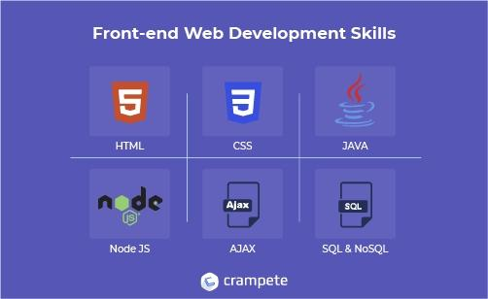
Front end

Slide 7
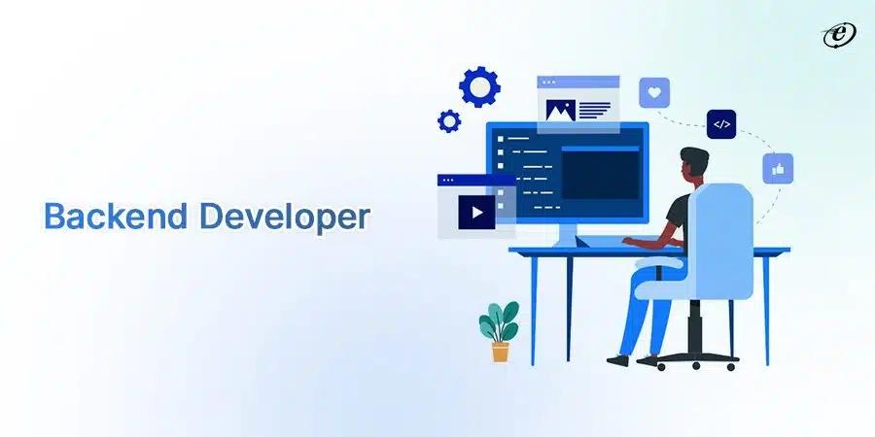
Back end

Slide 8
Modeling
The Bus Reservation System will improve the efficiency, convenience, and comfort of the reservation process.
They can see whether there are any open positions on a given date.
Customers can reserve the seats they want.
They can review all available seats at a glance and select seats easily.
To reserve a bus ticket, customers just have to select a date, the start location and the end destination, and go through the intuitive step-by-step booking process.

Slide 9
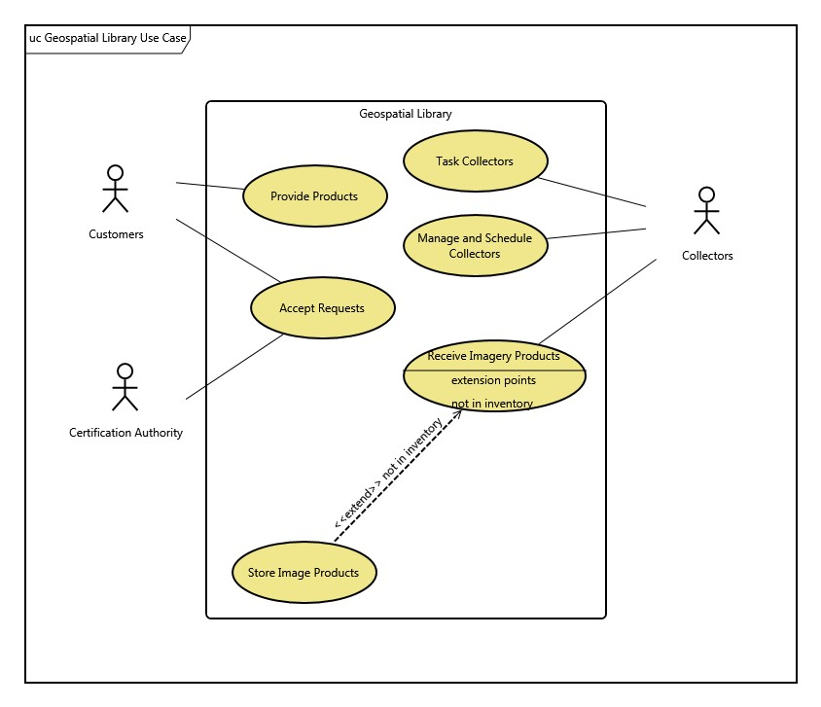

Slide 10
Result
Project Result means the outcome of the Project as evaluated and measured against the Project’s Key Performance Indicators, approved performance deliverables, objectives, targets and key milestones of the Project and any other additional conditions of the above as specified in Schedule 2.
The outcome of a project results in deliverables. Anything that’s produced during the project’s development such as documents, plans, and project reports is considered a deliverable.
The results are generally positive improvements to the lives of the beneficiaries.
the changes or effects expected to take place after implementing the project.

Slide 11
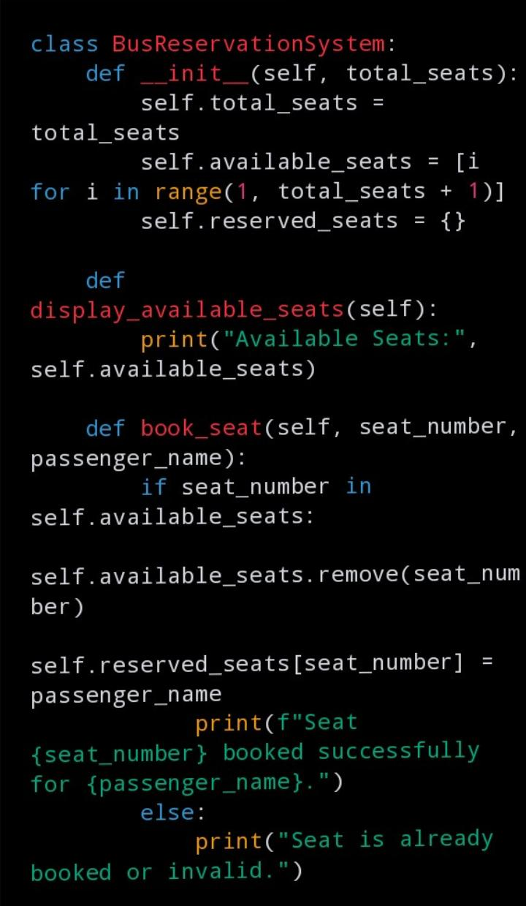
Screenshot

Slide 12
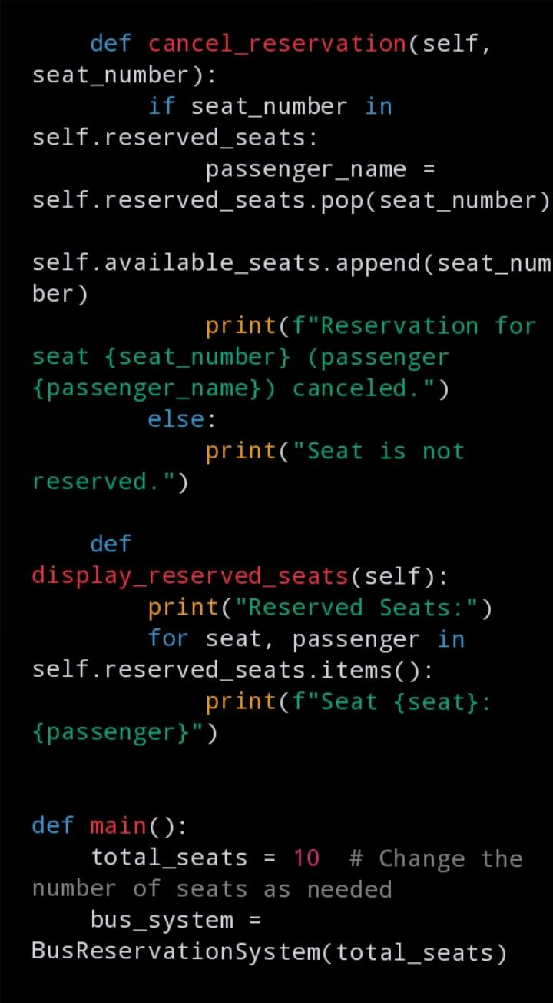
.

Slide 13
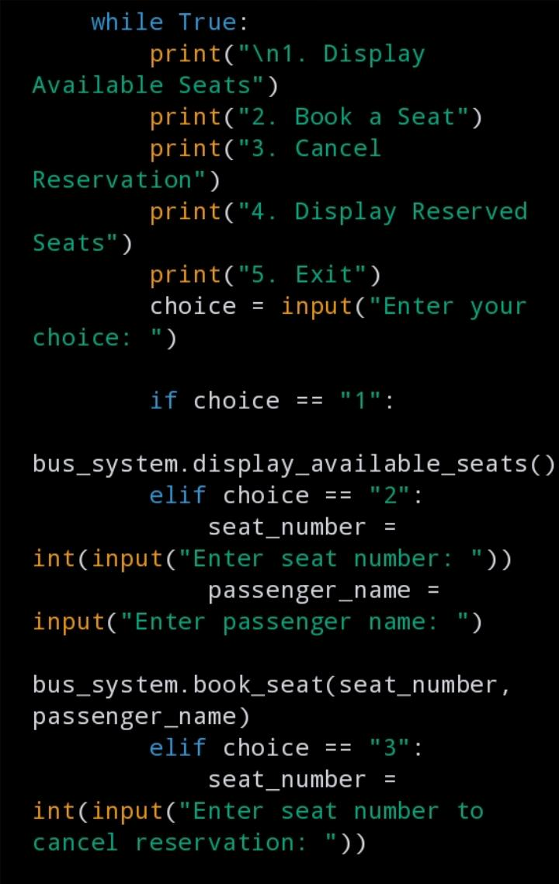
.

Slide 14
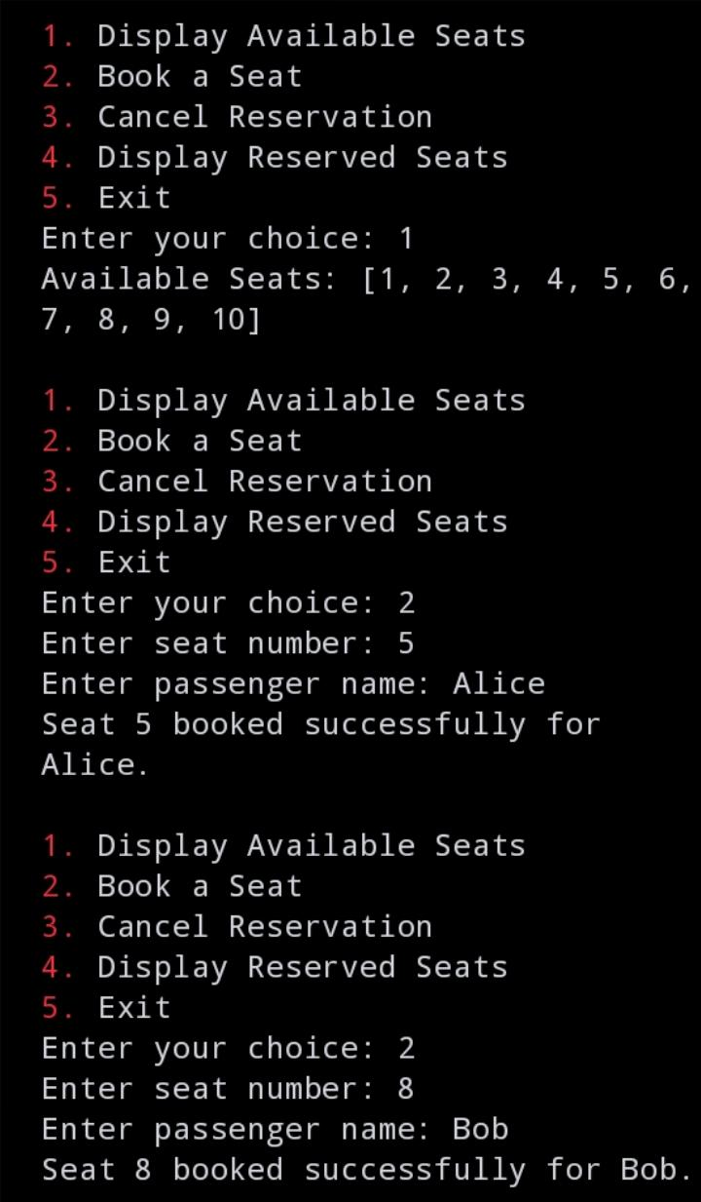
Output

Slide 15
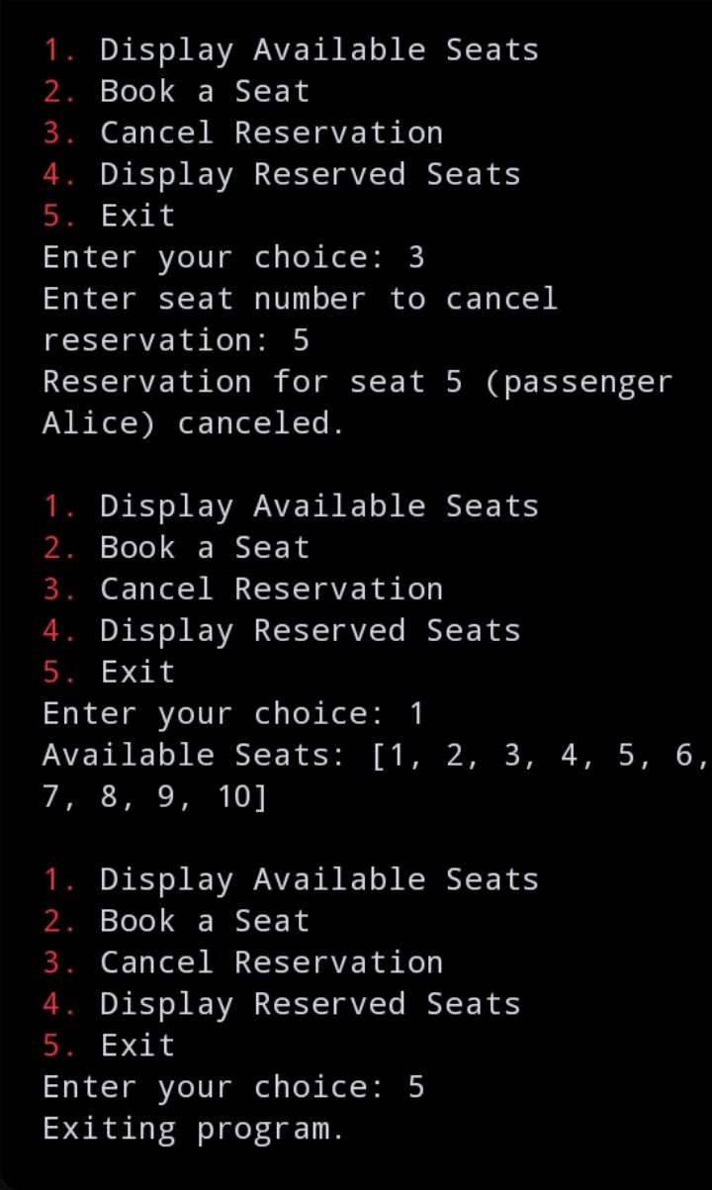
.

Slide 16
Future enhancement
Although it may come as a surprise, there are still places where travelers must redeem tickets purchased online at a bus station or through an agency.
Long-distance operators will almost certainly add far more flexible demand-driven pickup and drop-off places where the bus will only stop if a customer has booked a ticket in advance.
Fewer personnel mean improved cost efficiency in most places of the modern world.
Implementing demand-based yielded pricing, which has shown to be a crucial factor of success for many operators, requires real-time seat and sales management.

Slide 17
Conclusion
Provide customers with a personalized easy-to-utilize user experience for booking and purchasing tickets online.
It stores customers’ personal data records, scheduled routes, frequent trips, drop points, and other information.
You need Internet access. You need to be ready for an influx of new customers. Not all online booking systems are created equal. Avoid booking systems that don’t bring you new quality customers.

Slide 18
.
Thank You

